Slide 1
Regression

Slide 2
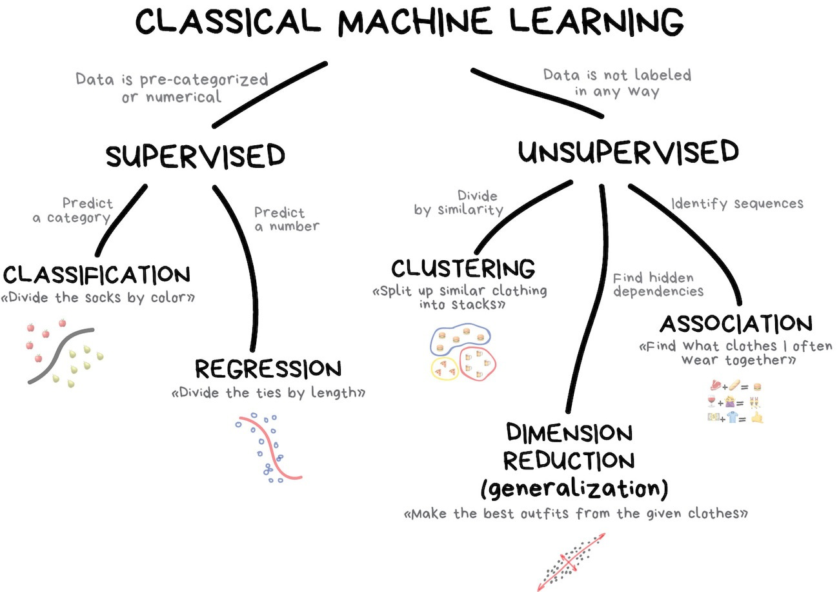

Slide 3
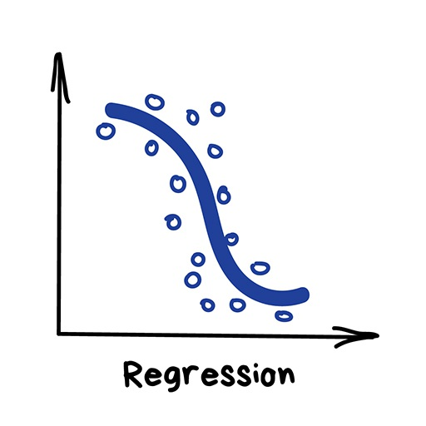
Regression
"Draw a line through these dots”
Today this is used for:
Stock price forecasts
Demand and sales volume analysis
Medical diagnosis
Any number-time correlations
House price prediction
Flight price prediction
…

Slide 4
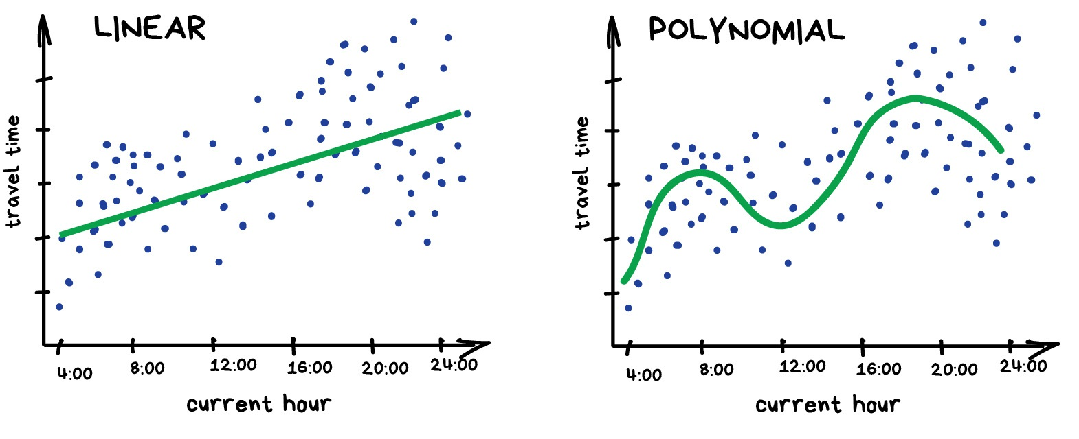
Regression

Slide 5
Regression
Everyone who works with finance and analysis loves regression.
It's even built-in to Excel. And it's super smooth inside — the machine simply tries to draw a line that indicates average correlation.

Slide 6
Regression Analysis…
Our objective is to analyze the relationship between interval variables;
Regression analysis is used to predict the value of one variable (the dependent variable) on the basis of other variables (the independent variables).
Dependent variable: denoted Y
Independent variables: denoted X₁, X₂, …, X_{k}

Slide 7
A Model…
A model of the relationship between house size (independent variable) and house price (dependent variable) would be:
House
Price:
Y
Building a house costs about
$75 per square foot.
House Price = 25000 + 75 * Size
Most lots sell
for $25,000
House size: X
In this model, the price of the house is completely determined by the size.

Slide 8
A Model…
In real life however, the cost of houses will vary, even among for houses of the same size:
Lower vs. Higher
Variability
House
Price:
Y
25K$
House Price = 25,000 + 75*Size +
x
House size: X
Same square footage, but different price points
(e.g. décor options, cabinet upgrades, lot location…)

Slide 9
Random Term…
We now represent the price of a house as a function of its size in this Probabilistic Model:
y = 25,000 + 75x + ,
where (Greek letter epsilon) is the random term (a.k.a. error variable).
It is the difference between the actual selling price and the estimated price based on the size of the house (model based price) .
Its value will vary from house sale to house sale, even if the square footage (i.e. x) remains the same.

Slide 10

Simple Linear Regression Model…
Generally, a straight line model with one independent variable is called a simple linear regression model.
dependent
variable
independent
variable
y-intercept
slope of the line
error term

Slide 11


Simple Linear Regression Model…
Note that both and are population parameters which are usually unknown and hence estimated from the data.
y
rise
run
=slope (=rise/run)
=y-intercept
x

Slide 12
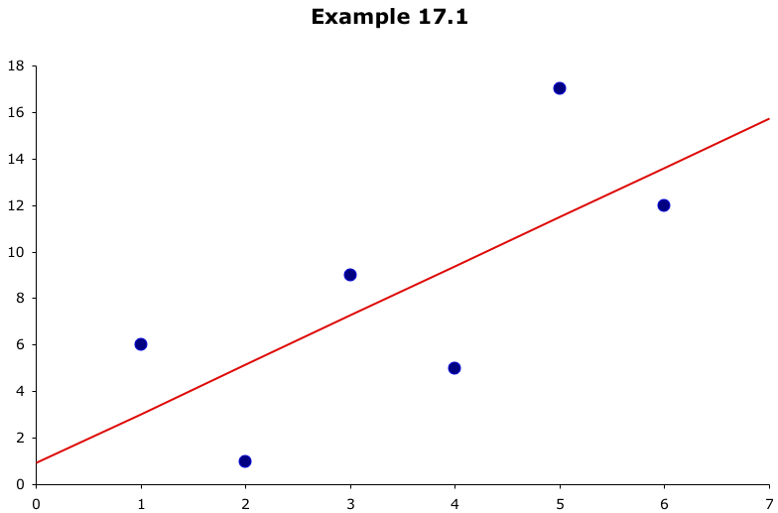
Which line has the best “fit” to the data?
?
?
?

Slide 13



Estimating the Coefficients…
In much the same way we based estimates of on , we estimate from b₀ and from b₁, the y-intercept and slope (respectively) of the least squares or regression line given by:
(Recall: this is an application of the least squares method and it produces a straight line that minimizes the sum of the squared differences between the points and the line)

Slide 14
Estimating the Coefficients…
In much the same way we based estimates of on , we estimate from b₀ and from b₁, the y-intercept and slope (respectively) of the least squares or regression line given by:
(Recall: this is an application of the least squares method and it produces a straight line that minimizes the sum of the squared differences between the points and the line)

